Slide 1
Journal Club – June 30, 2017 – Felipe Gerhard

Slide 2
https://courses.cs.washington.edu/courses/cse528/07sp/izhi1.pdf
http://redwood.berkeley.edu/vs265/izhikevich-which-nn04.pdf

Slide 3
Simple model of spiking neurons (Izhikevich, 2003)

Slide 4
The adaptive quadratic integrate-and-fire model (Izhikevich, 2003)

Slide 5
The adaptive quadratic integrate-and-fire model (Izhikevich, 2003)

Slide 9
https://arxiv.org/abs/1602.07389

Slide 10
Generalized Linear Model

Slide 11
Tonic Spiking

Slide 12
Bursting

Slide 13
Bistability

Slide 14
Type I and Type II firing

Slide 16
Classification of firing patterns

Slide 17
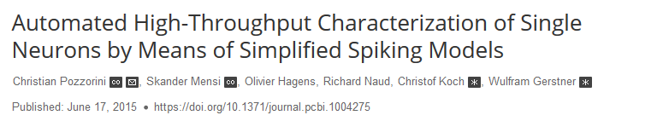
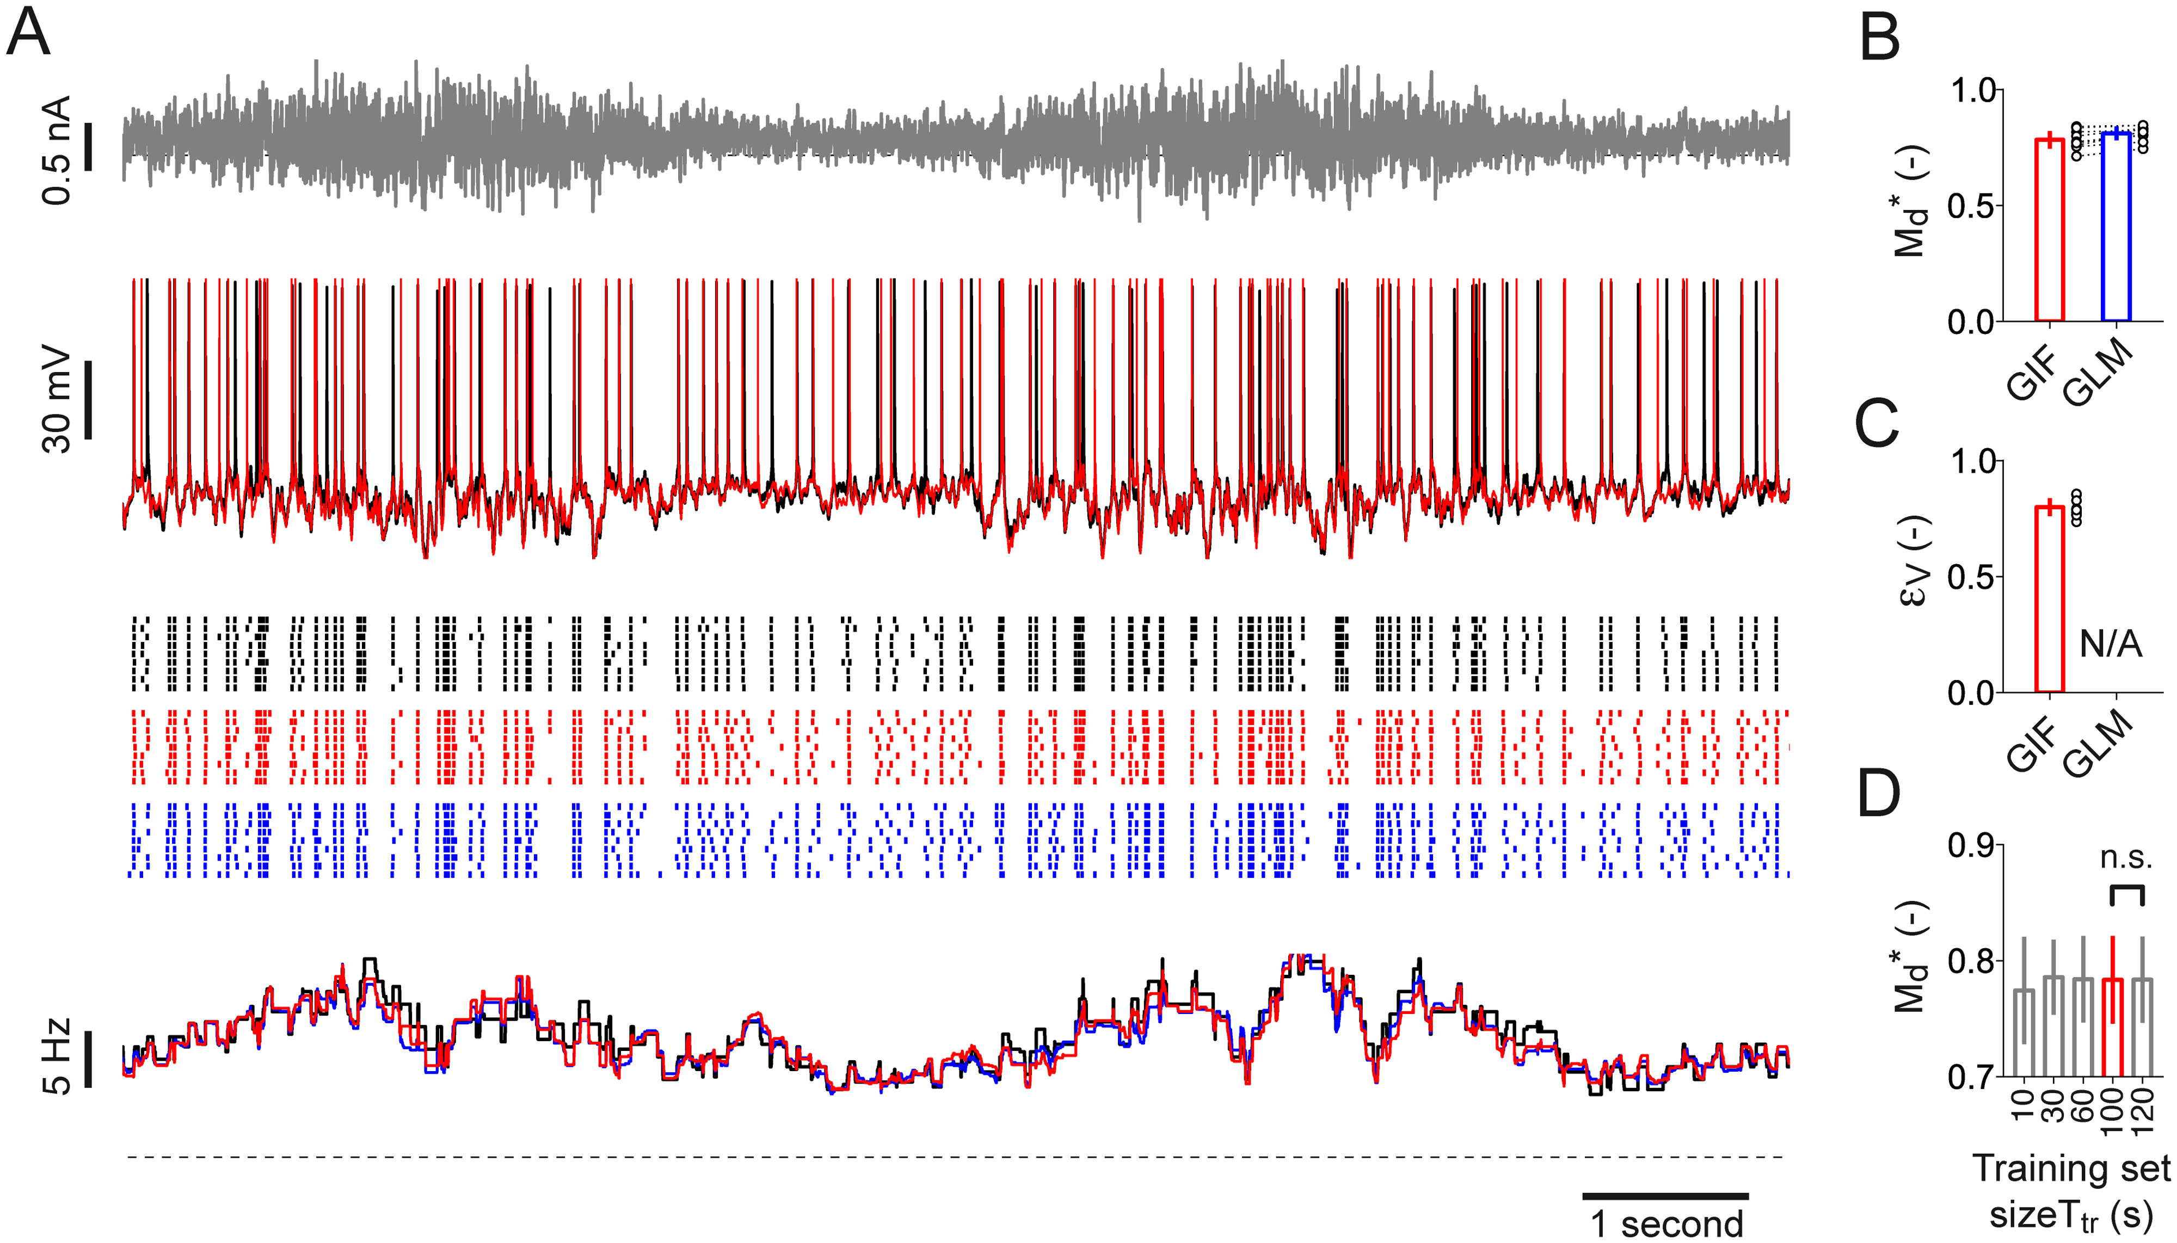
http://www.nature.com/neuro/journal/v16/n7/full/nn.3431.html
http://journals.plos.org/ploscompbiol/article?id=10.1371/journal.pcbi.1004275

Slide 18
